Slide 1
Art Deco

Slide 2
INTRODUCING ART DECO
Art Deco is a visual art style, design and architecture that first appeared to the world in Paris, France before World War 1. The name arts Deco was taken due to the International Exhibition of Modern Decorative and Industrial Arts. The exposition took place in 1925.

Slide 3
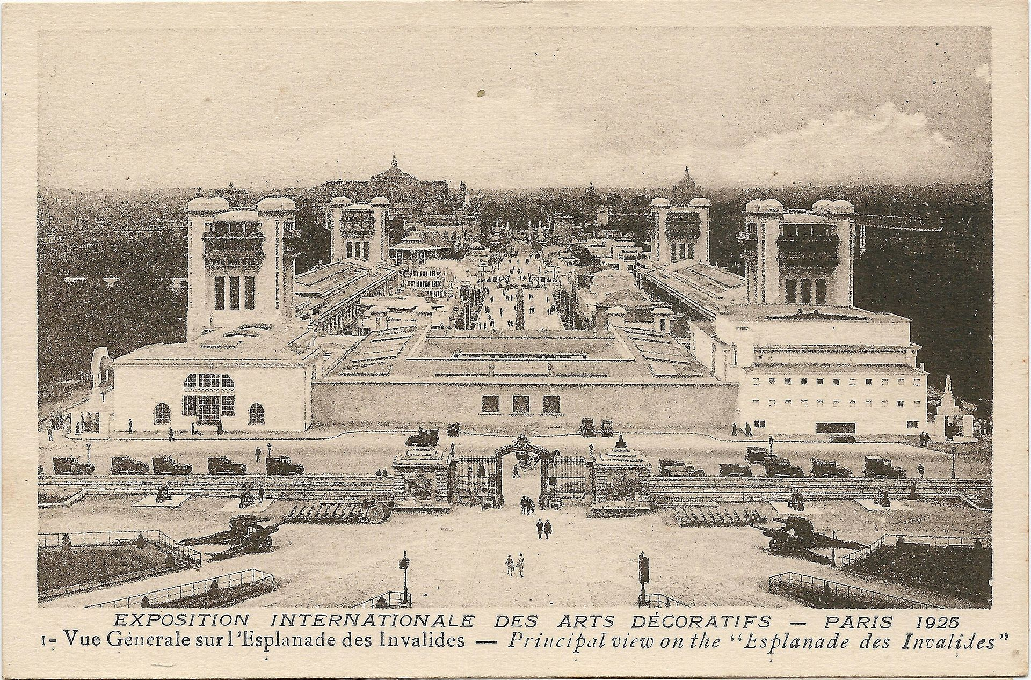

Art Deco
The exposition was a World’s Fair-Styled spectacle and it lasted for about six months.
It covered around 57 acres of land in Paris.
A popular show based on the exposition toured the United States the following year.

Slide 4
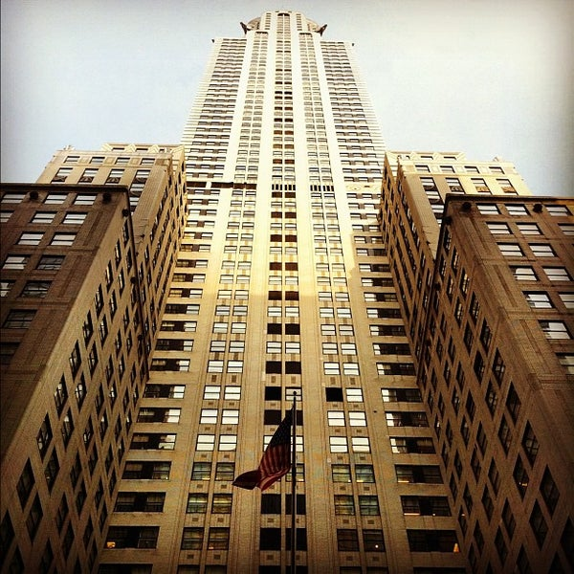
Chrysler Building
The Chrysler building was chosen because it is the first Mega-Height building taking the title of World's Tallest Building for 11 months before Empire state the building surpassed it in 1931. It is still the world’s tallest building of brick with a frame steelwork.

Slide 5
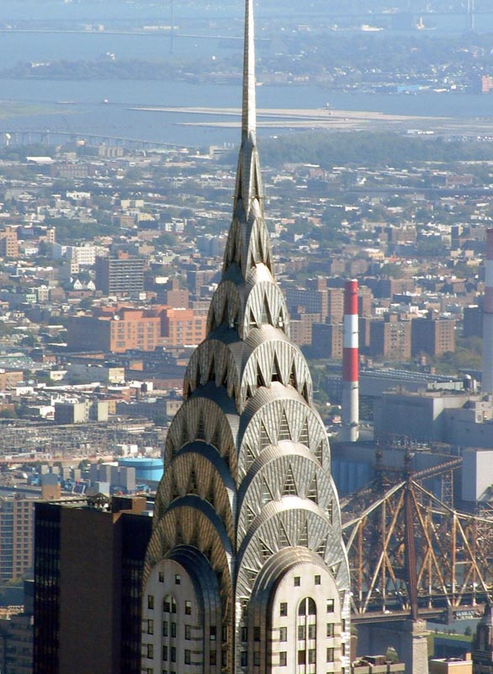
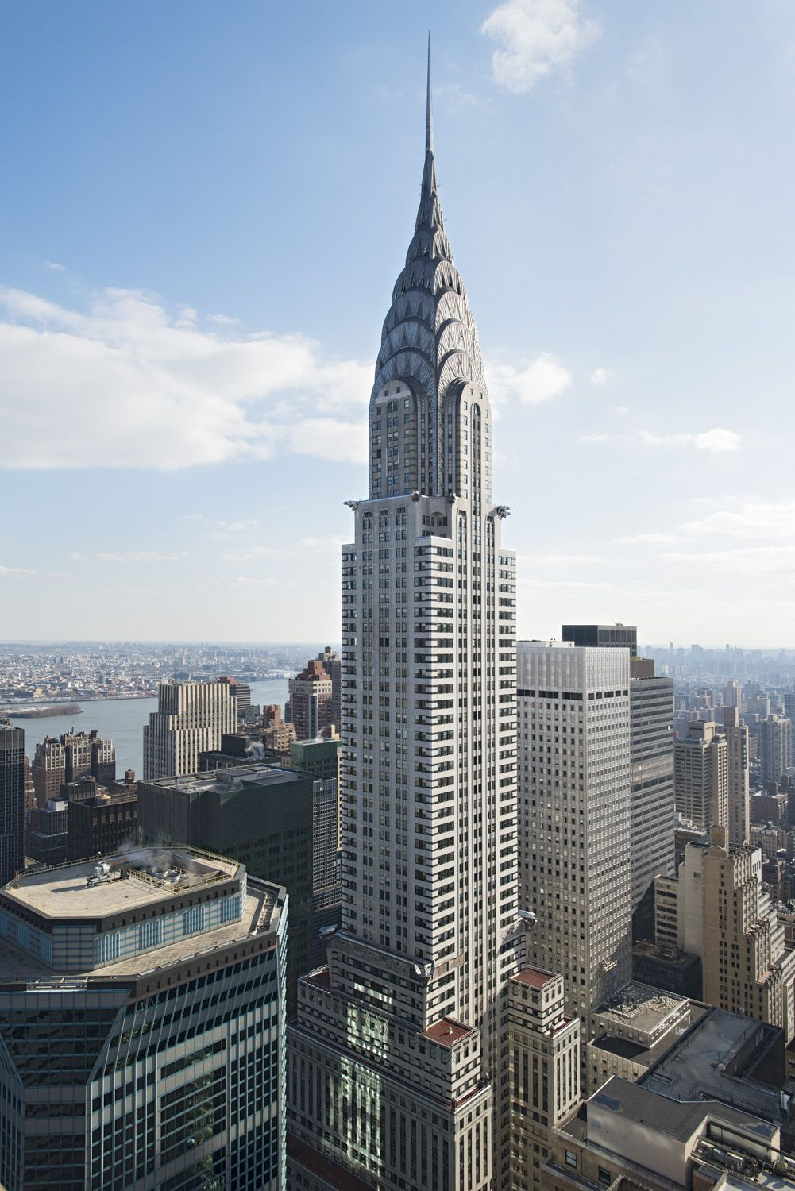
Chrysler Building
The building earned the Tallest tower title when it raised its tapered tower 125 feet in just 90 minutes secretly. It has enjoyed commercial success due to being located next to the Grand Central Station. In 2009, the Chrysler Building was renovated and awarded LEED Gold certification for existing large buildings.

Slide 6
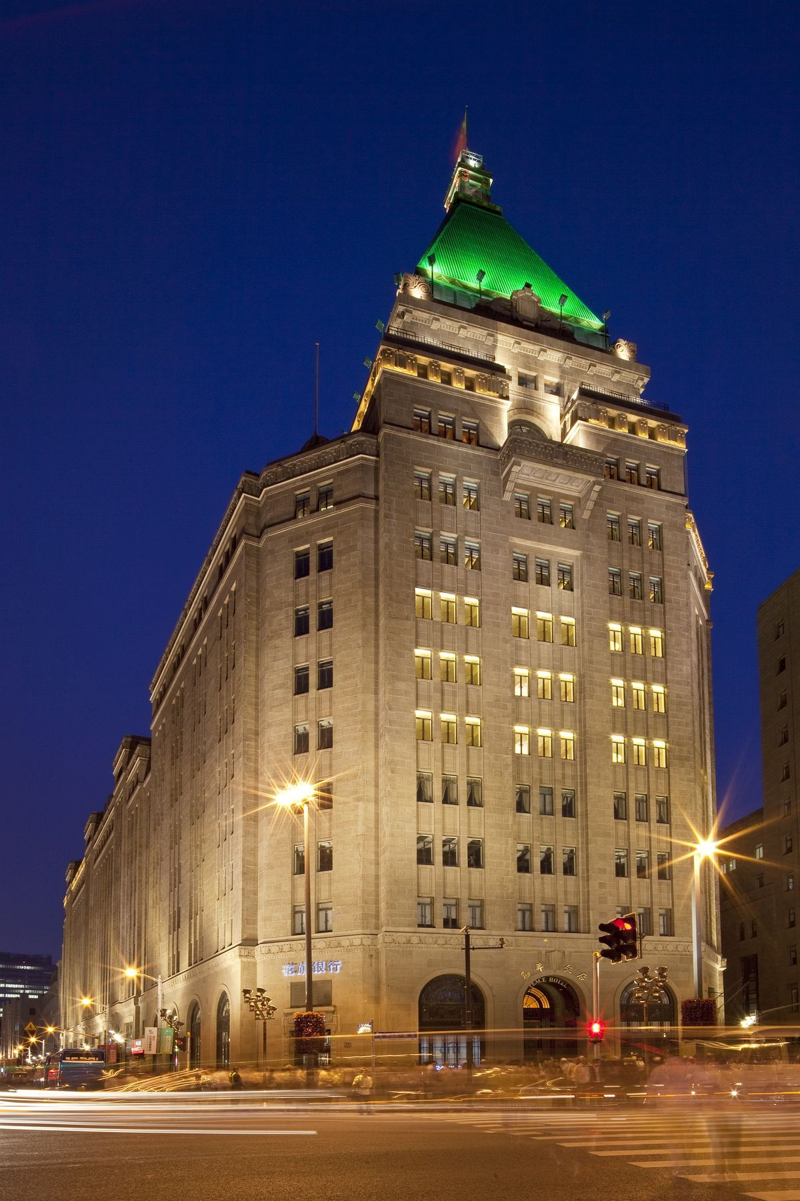
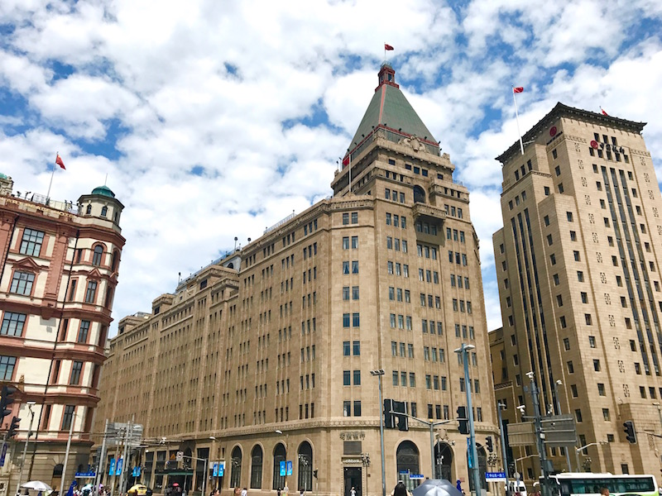
Eastern Columbia
It is Located on the Bund, the Cathay Hotel building, Now known as the Fairmont Peace Hotel, it’s one of Shanghai’s Art Deco gems.
The building was commissioned by Real-Estate tycoon Sir Victor Sassoon and completed in 1929.

Slide 7
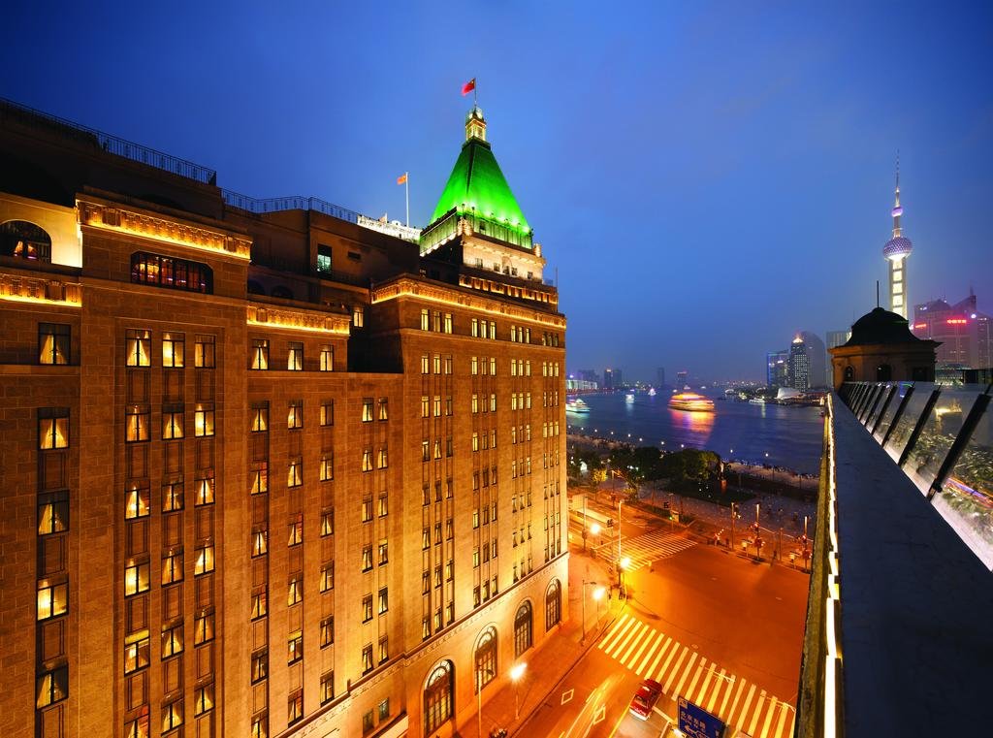
Fairmont Peace Hotel
The Fairmont Peace Hotel in China, Shanghai was chosen because it has been a landmark for more than a century.
They have incorporated the old fashion that sparkle shines with new luster. The hotel is Located on the Bund facing the Pudong which are over the Huangpu River.
It’s the perfect place to explore the beautiful view of Shanghai city.

Slide 8
Chrysler Building VS. Fairmount Peace Hotel
Chrysler building and Fairmount peace hotel are both Art-Deco style skyscrapers.
They both prime business centers in their cities respectively to New York and Shanghai.
They also provide a great view to the cities and are attraction cites.
Fairmount peace hotel is close to the Bund International Architecture Exhibition and Heping Fandian

Slide 9
Chrysler Building VS. Fairmount Peace Hotel
Chrysler building was built from the period of the Great Depression in 1930- 1950.
It’s a special building since it has a steel framework and build of brick.
Fairmount Price hotel building has stood the test of time it was built in 1929 and almost a century now.

Slide 10
Critics of the Buildings
The British never tolerated the art deco buildings.
They had an attitude same as that of the Duke of Windsor.
Ordinary people like the buildings a lot and they find them amazing cites.
Some people find it a risk to human life.
If such buildings happen to have errors then a large number of people could loose their lives in case it caves in.

Slide 11
Own Criticism
The buildings have a great impact to the economy of a nation.
They are more spacious and can hold a large number of offices and businesses in them.
The building s conserve space- land which is a limited resource in the urban centers hence they are recommendable.
The buildings also beautify the sceneries of cities and this provides other platforms such as entertainment capturing scenes.

Slide 12
Comparison of the buildings
Chrysler building is taller (in height) than Fairmount Peace Hotel. Eastern Colombia on the other hand has a medium height, neither is it too tall nor is it too short.
Chrysler building is vertical with the stalls moving upwards while Fairmount Peace hotel has its rooms arranged horizontally.
One similarity between the three buildings is that they are attractive and beautiful. Their designs and architect are superb.

Slide 13
Criticism
The Chrysler building has the ordinary design like other skyscrapers. It would have been better if it was circular (round) as it goes up.
The top of the Chrysler building shows no creativity. The building could have been more peculiar if it had some designs at the top. The pointed end is not attractive at all.
Fairmount Peace Hotel is just like any other building. It does not have any unique designs and paintings. Also, the building is short, it would have been better if it was tall.
Eastern Columbia just like Fairmount Peace Hotel does not have the advantage of being very tall. The designing is also ordinary with no creativity or uniqueness.

Slide 14
Conclusion
Art Deco invention has led to subsequent development of the architectural industry.
The efforts that have been made, not only mark the development of a city but also creates employment opportunities for thousands.
There should be further inventions of different styles that mark Art Deco just as the technology is advancing.

